Slide 1
What impact has Covid had on the housing market?
Brian Dorricott
MiniProject 2
Institute of Data

Slide 2
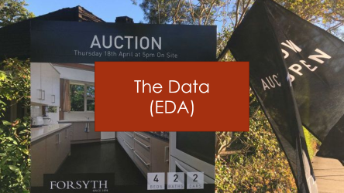
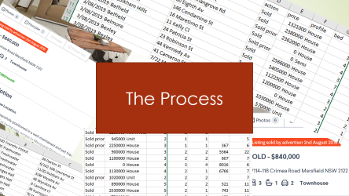


Agenda

Slide 3
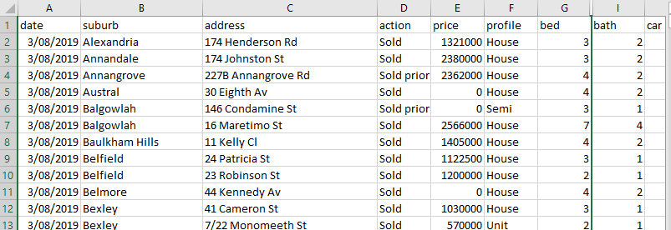
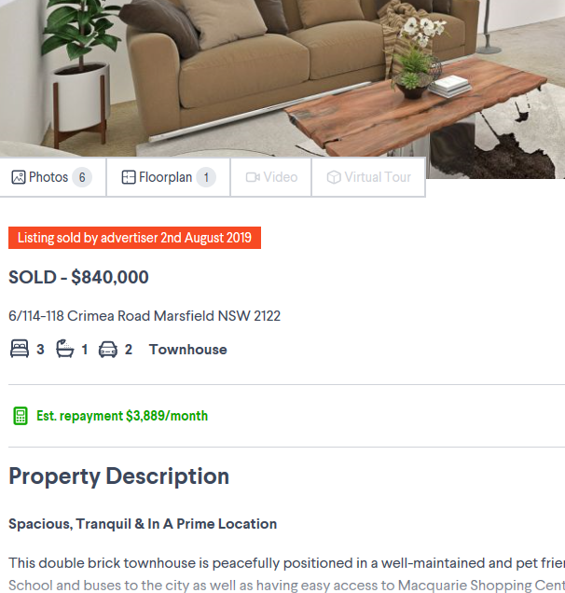
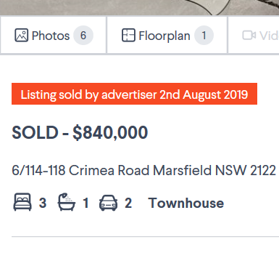
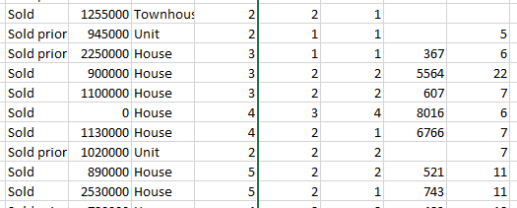
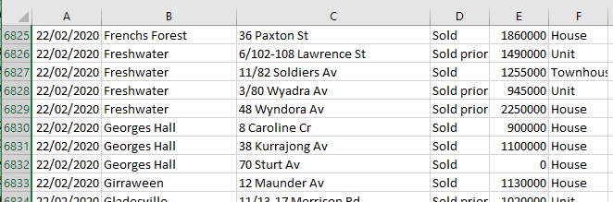
The Process

Slide 4
Pathway of how we did this
Business
Question
Obtain Data
Wisdom
Analyse
Visualise

Slide 5
Sydney Stations
1075 rows
7 features
18 unneeded features
Distance to stations
Domain Website
30,000 rows
27 features
Our Data
18,269 rows
9 features
LGAs
8439 rows
5 features
Suburbs in LGAs

Slide 6
The Process
Decide:
Date – Monthly or Quarterly
Region – Suburb or LGA
Comparison – Absolute Price or Change
Calculate price in each period for “average” house in that region

Slide 7
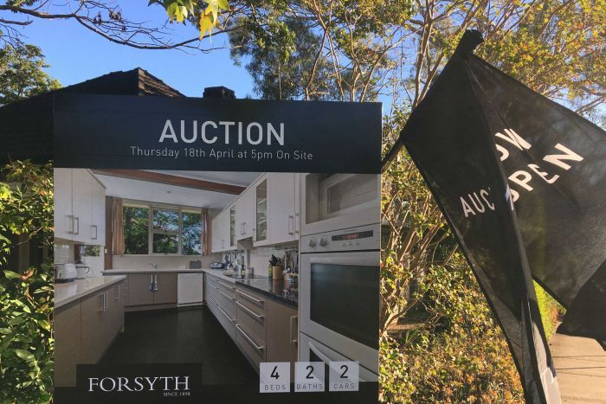
The Data
(EDA)

Slide 8
The Feature set
Suburb
LGA Region
Bathrooms
Bedrooms
Car Spaces
Nearest Station (m)
Central Station (m)
Date
Price

Slide 9
32 Councils that participated
Ashfield Council
Auburn City Council
Bankstown City Council
Blacktown City Council
Burwood Council
Camden Council
Canterbury City Council
City of Canada Bay Council
Fairfield City Council
Gosford City Council
Holroyd City Council
Hurstville City Council
Kogarah City Council
Ku-ring-gai Council
Lane Cove Municipal Council
Leichhardt Municipal Council
Manly Council
Marrickville Council
Mosman Municipal Council
North Sydney Council
Pittwater Council
Randwick City Council
Rockdale City Council
Ryde City Council
Sutherland Shire Council
The Council of the City of Botany Bay
The Council of the Shire of Hornsby
The Hills Shire Council
Warringah Council
Waverley Council
Willoughby City Council
Woollahra Municipal Council

Slide 10
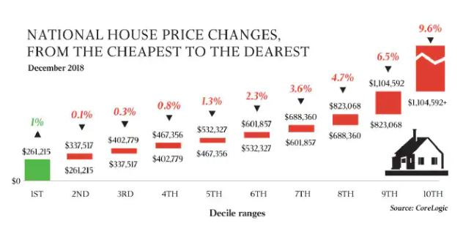


What have we discovered?

Slide 11
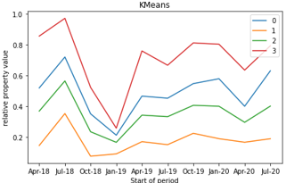
Prices go up & down together
Orange (1) – 9 LGAs
Auburn, Camden, Canterbury, Gosford, Rockdale
Green (2) – 10 LGAs
Lane Cove, Sutherland, The Hills, North Sydney, Kogarah City
Blue (0) – 7 LGAs
Leichardt, Manly, Randwick, Ryde, Warringah
Red (3) – 5 LGAs
Waverly, Woollahra, Ku-ring-gai, Willoughby, Burwood

Slide 12
Expensive property lost most value
Reverting back to pre-covid levels
There was a bigger “crash” in prices 2018Q4

Slide 13
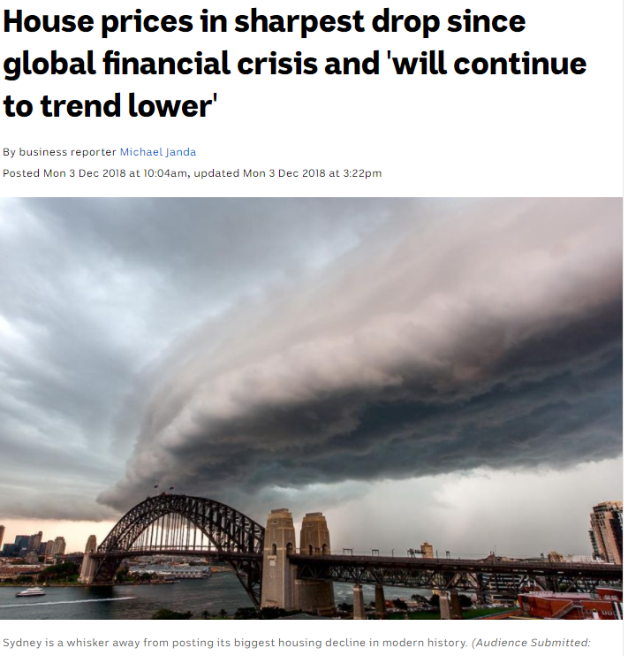
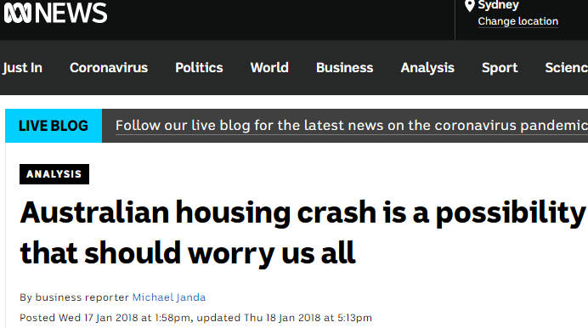
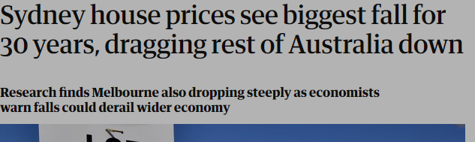

Slide 14
Where are the biggest changes
Seek to group all LGAs
Six methods used
KMeans
Birch
MiniBachKMeans
MeanShift
SpectralCulstering
GaussianMixture
Optimum number of groups? How big are they (we have 32 LGAs)

Slide 15
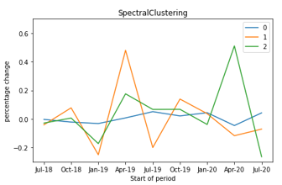
Four councils are outliers
Orange (1)
Woollahra Municipal Council
Rockdale City Council
Green (2)
Gosford City Council
Willoughby City Council
Blue (0)
Everyone else!

Slide 16
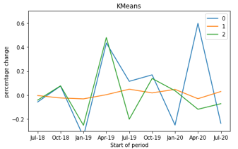
Three councils are outliners
Blue (0)
Willoughby City Council
Green (2)
Woollahra Municipal Council
Rockdale City Council
Orange (1)
Everyone else

Slide 17
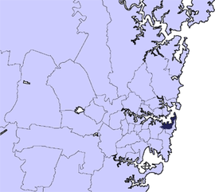
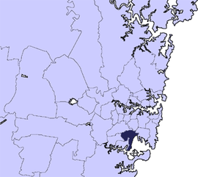
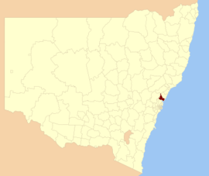
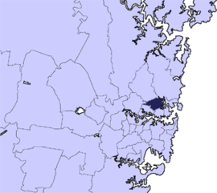
Where are these LGAs?
Woollahra Municipal Council
Rockdale City Council
Gosford City Council
Willoughby City Council

Slide 18
Just for the record
Analyse by suburb (rather than LGA)
Over 150 suburbs
Not enough data
Analyse by month (rather than quarter)
Large variations hide trends

Slide 19
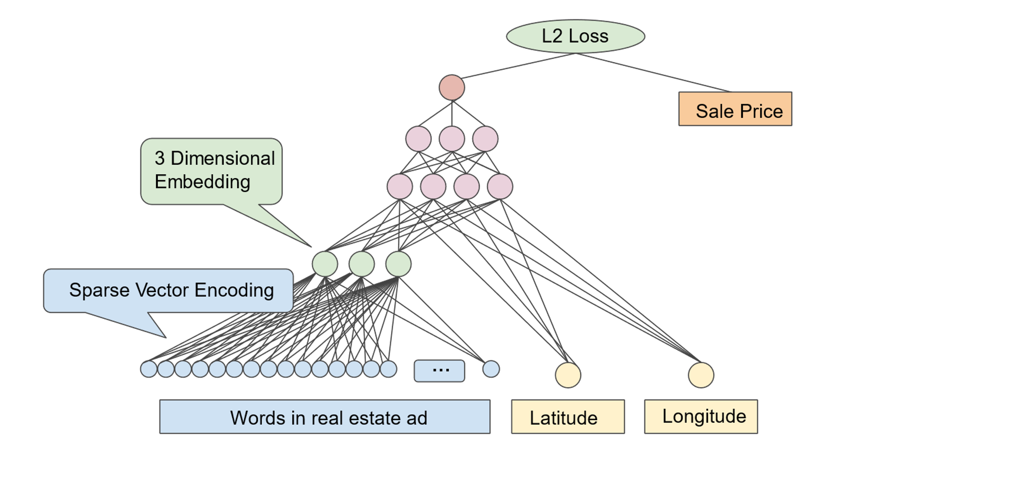
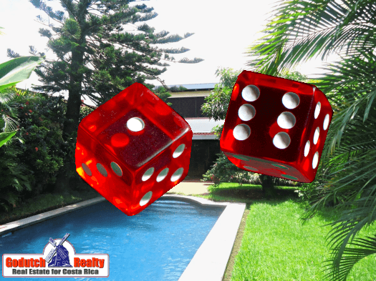
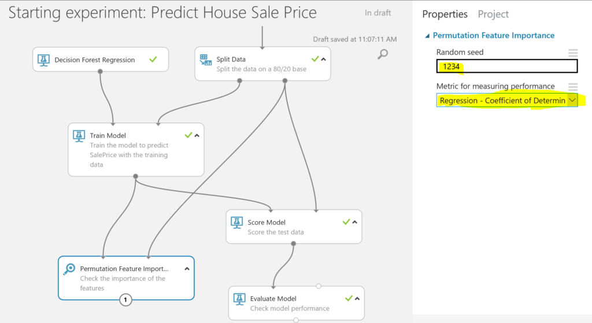

Future Analysis

Slide 20
What next?
Improve management of missing data
Add other data (e.g. number of photos)
Examine the different LR coefficients in LGAs
i.e. Impact of central station (m), beds, etc.
What is causing these outliers? How significant are they?
Adding categorical values
Complex…
What’s going on in Parramatta City Council?

